Slide 1

Scalability of
By. Pawan Panphinit
5809610107
CS447 – Operating System II

Slide 2
Scalability of
What is NetFlix ?

Slide 3
What is NetFlix ?
Scalability of
American entertainment company.
Founded in 1997.
By Randolph & Reed Hathings
Scott Valley, California, USA.
Videos Streaming
Movie, Series, TV Show

Slide 4
Scalability of
109.25 Millions users
World wide!

Slide 5
Scalability of
What wrong with NetFlix?

Slide 6
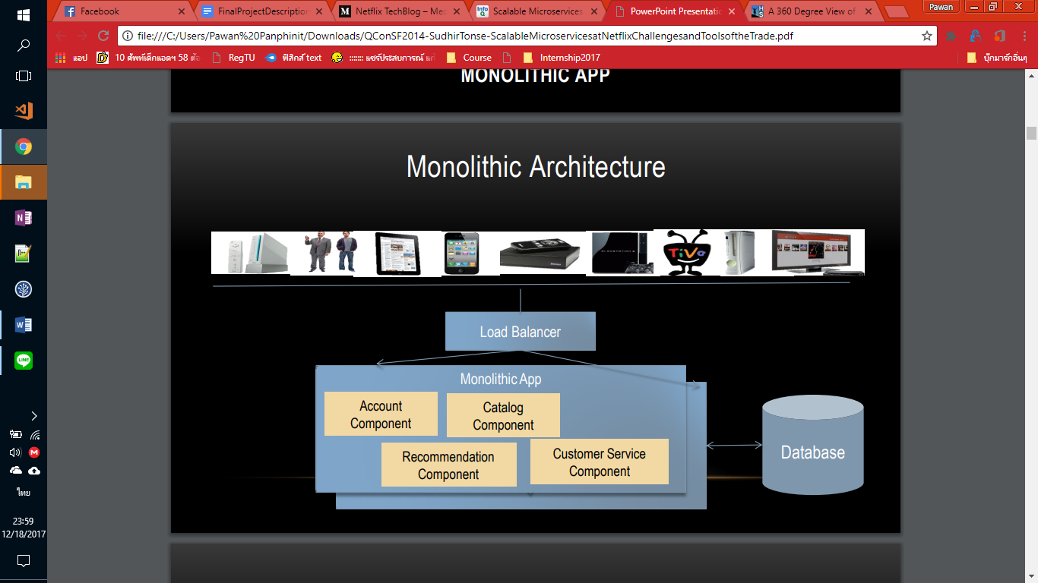
Monolithic Architecture
Scalability of
From https://www.infoq.com/presentations/netflix-ipc)

Slide 7
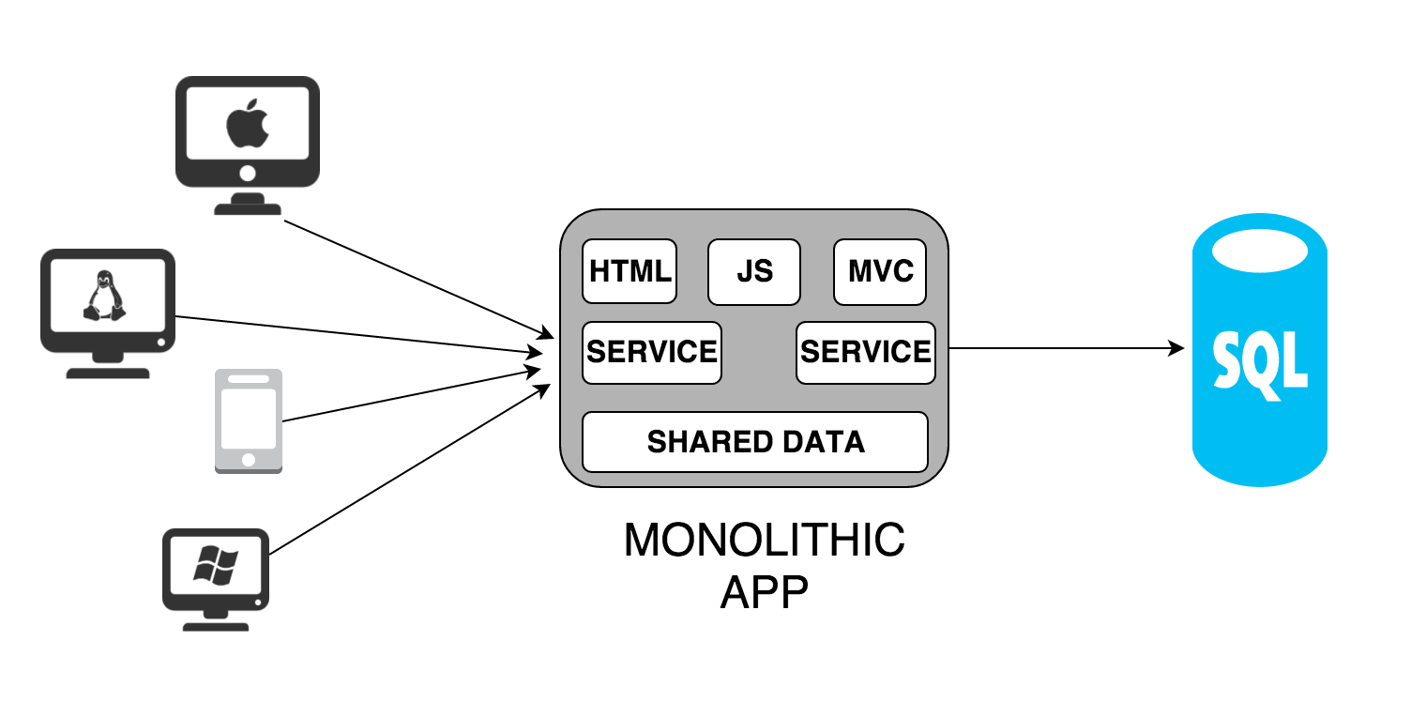
Monolithic Architecture
Scalability of
Database

Slide 8
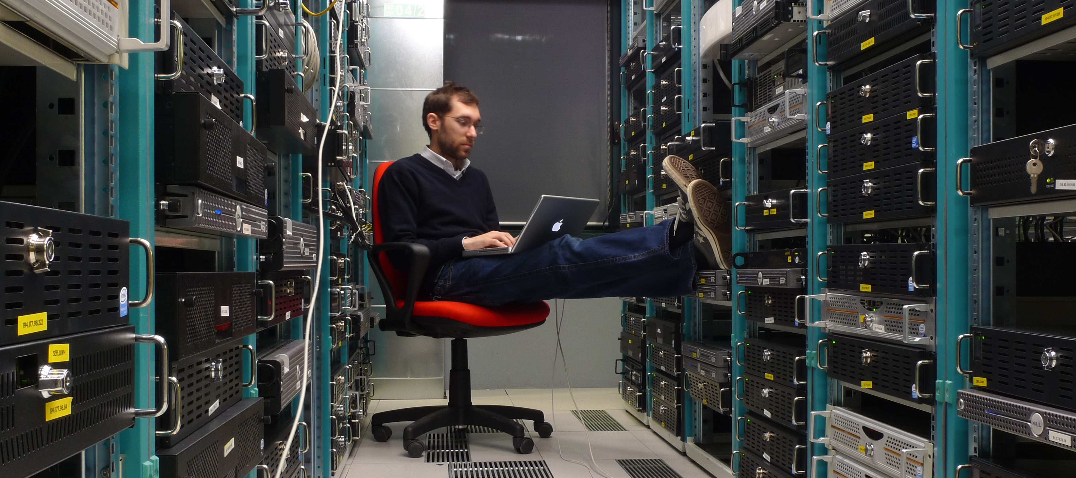
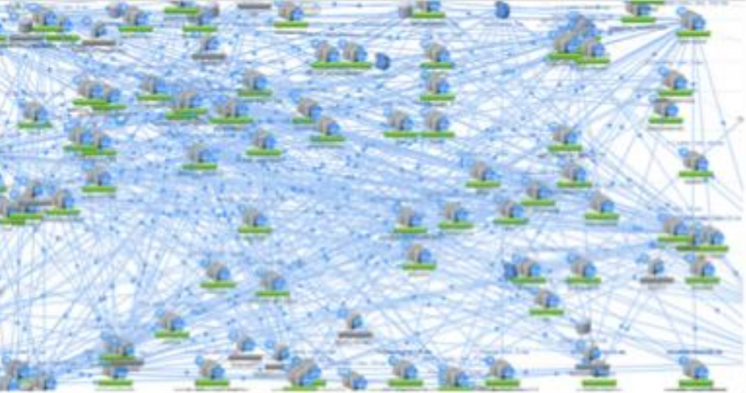
Traffic
Scalability of
From https://www.infoq.com/presentations/netflix-ipc)

Slide 9
Scalability of
How they fix?

Slide 10
From Monolithic -> MicroServices
Scalability of
From https://www.infoq.com/presentations/netflix-ipc)

Slide 11
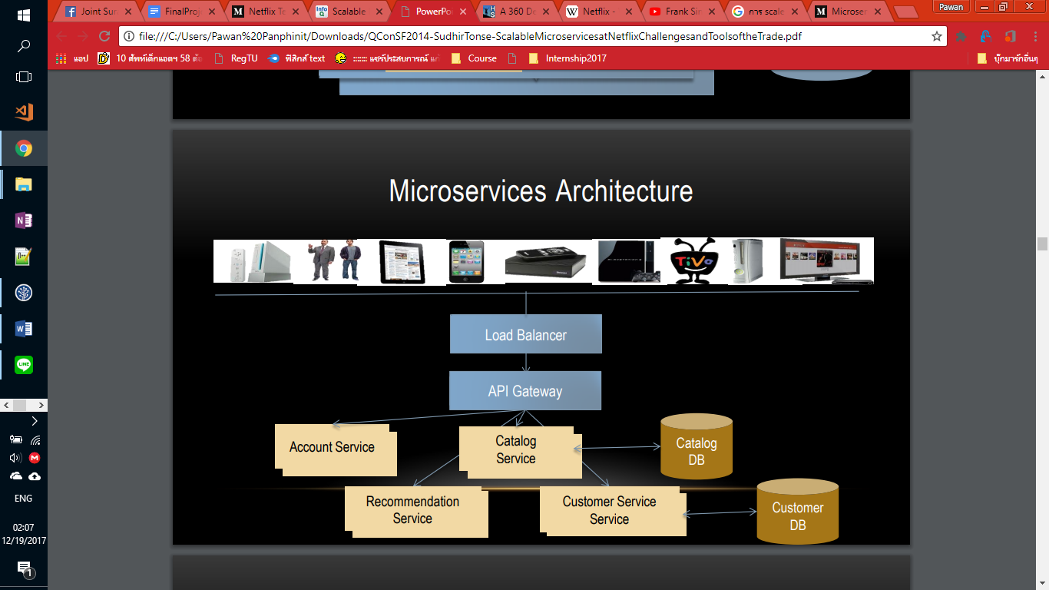
From Monolithic -> MicroServices
Scalability of
From https://www.infoq.com/presentations/netflix-ipc)

Slide 12
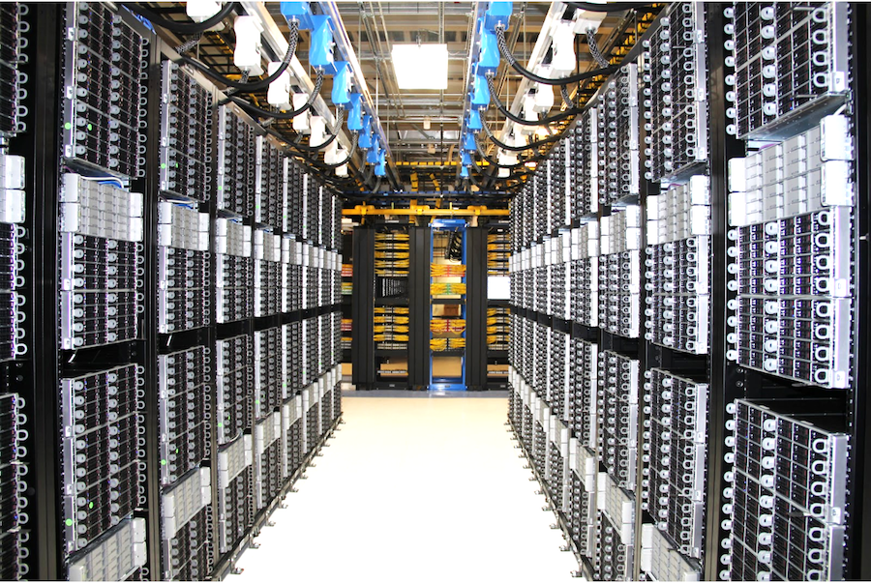
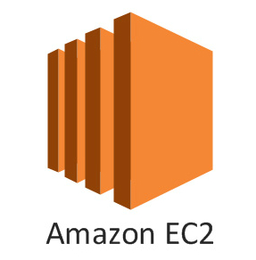
Use cloud server
Scalability of

Slide 13
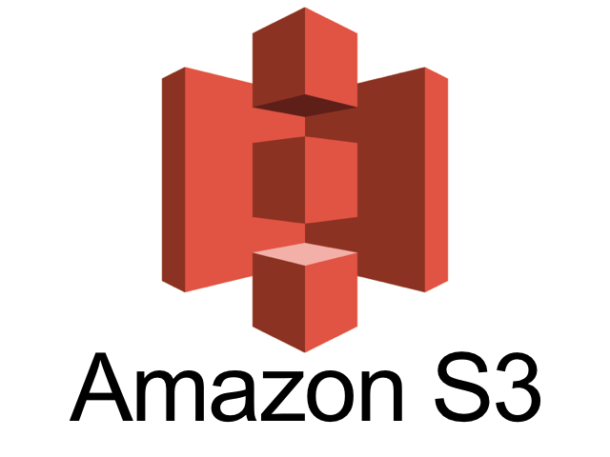
Use cloud server
Scalability of

Slide 14
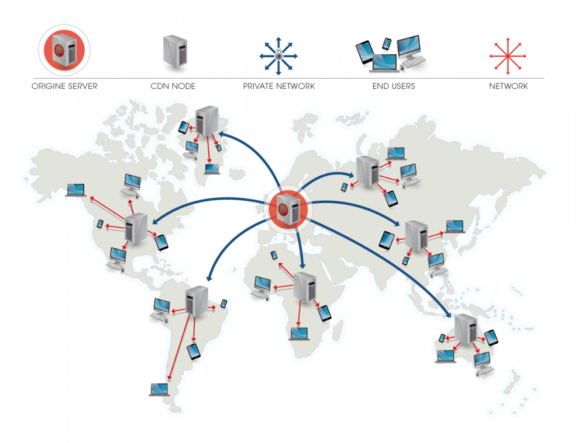
Use CDN
Scalability of

Slide 15
Scalability of
What happen to them?

Slide 16
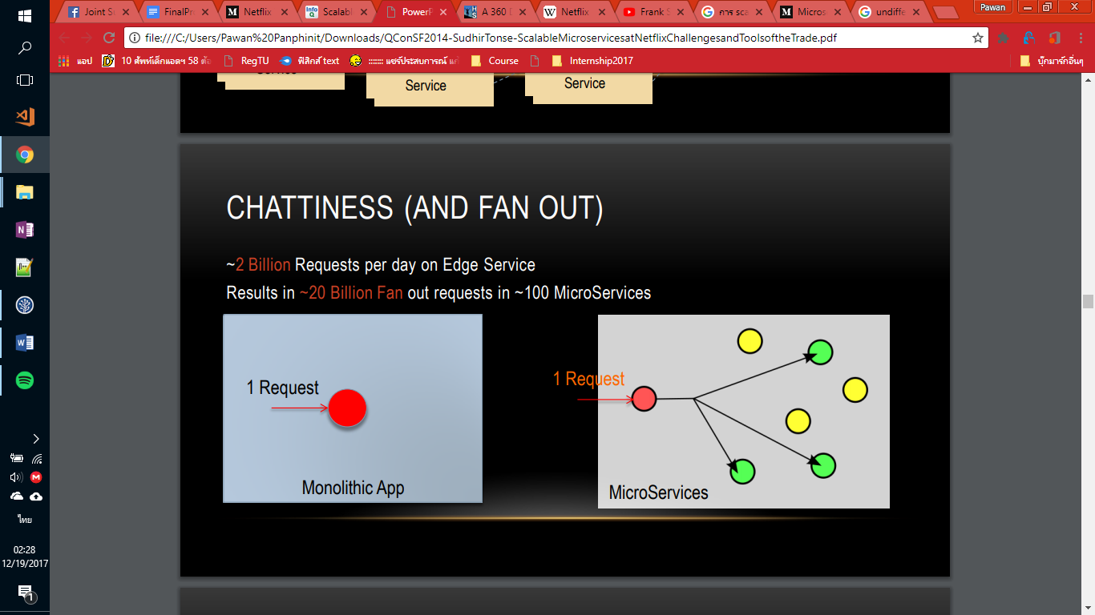
From Monolithic -> MicroServices
Scalability of
From https://www.infoq.com/presentations/netflix-ipc)

Slide 17
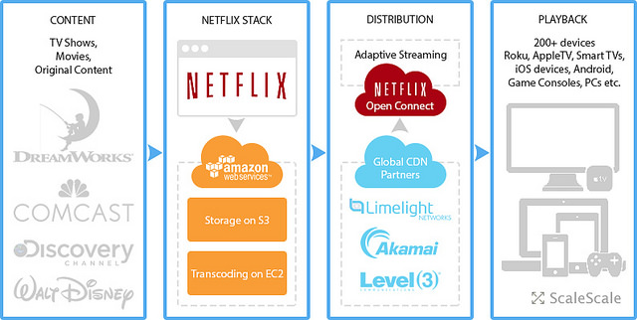
Scalability of

Slide 18
Scalability of
สิ่งที่เกี่ยวกับที่เรียนในคลาส

Slide 19
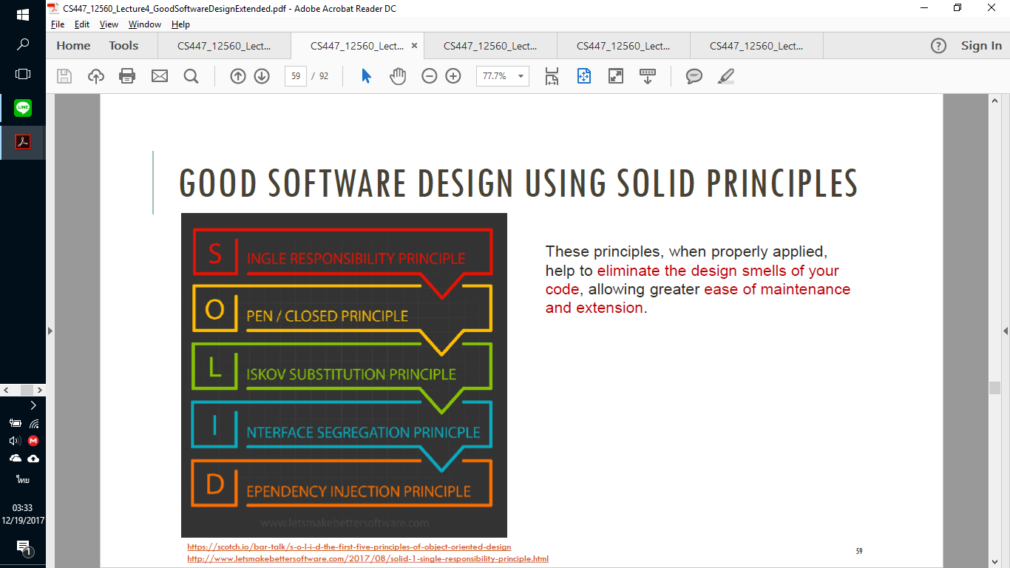
Good Software Design
Scalability of

Slide 20
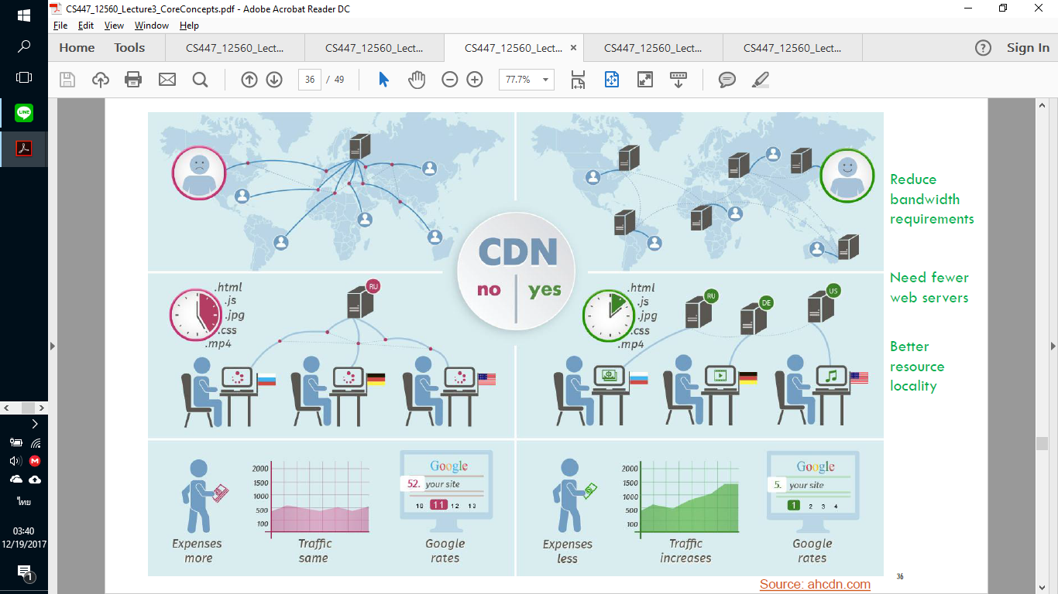
CDN: Content Delivery Network
Scalability of

Slide 21
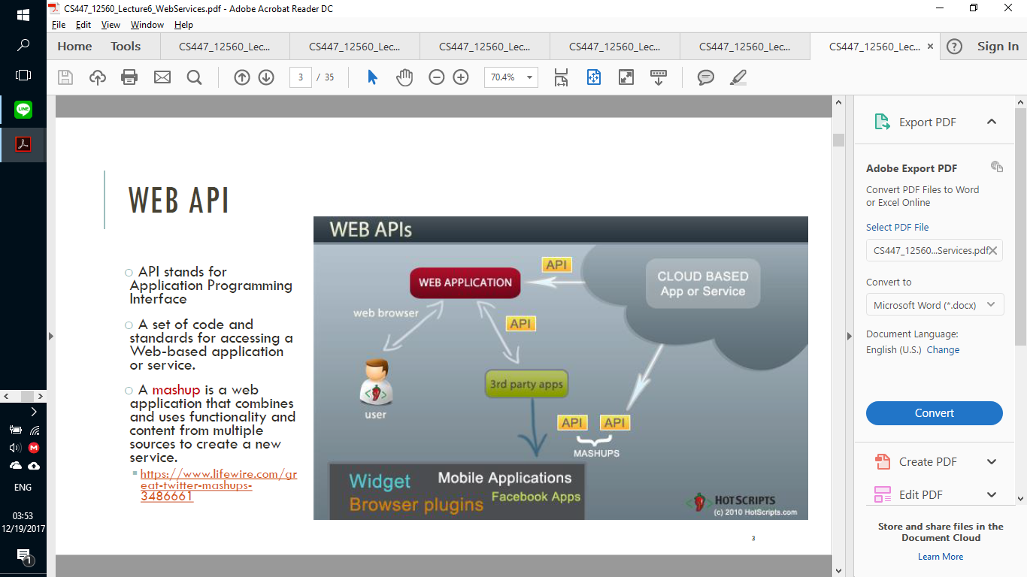
Web APIs
Scalability of

Slide 22
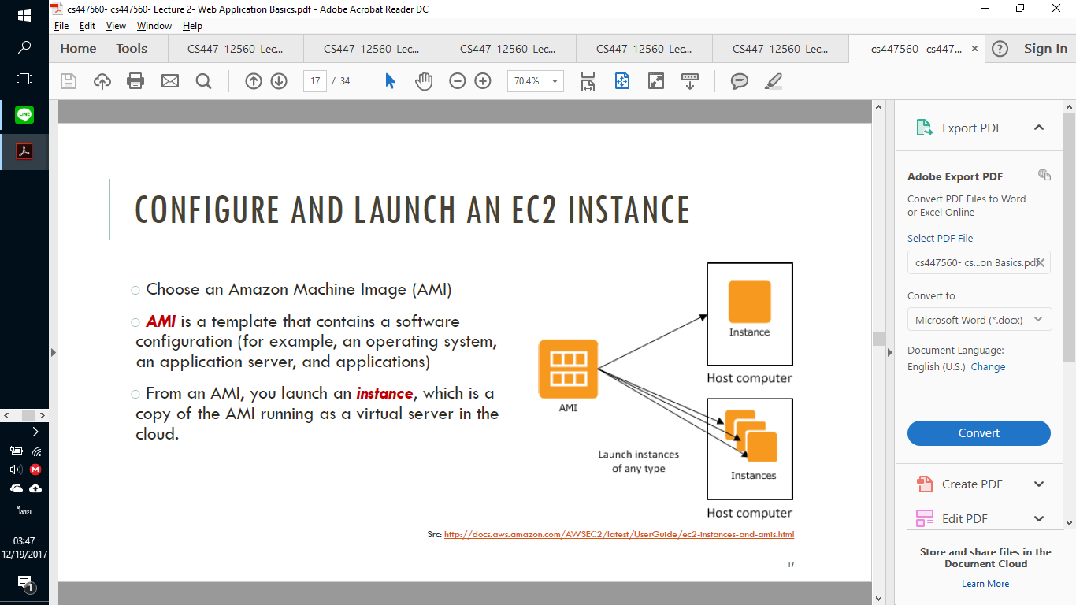
Amazon Web Service: EC2
Scalability of

Slide 23
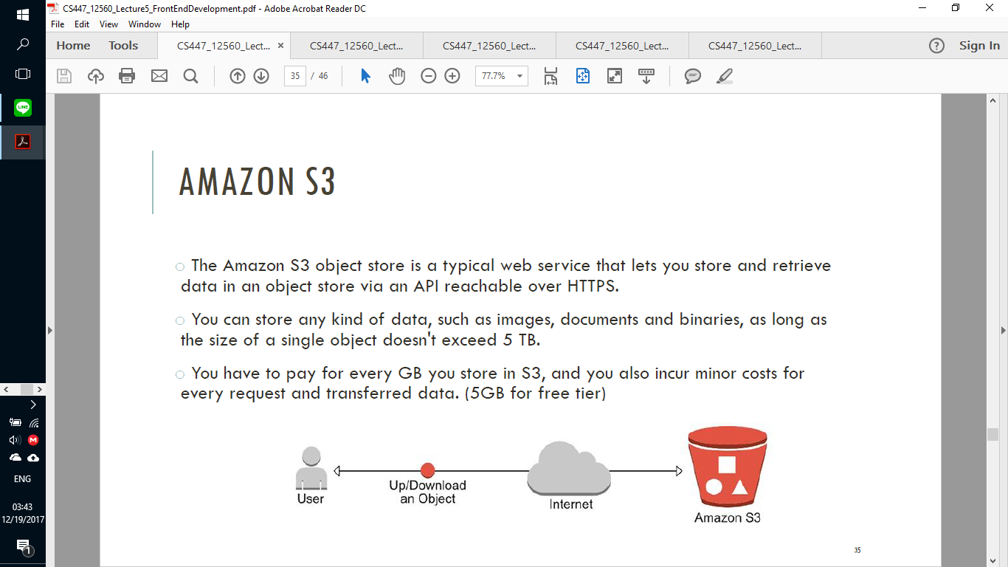
Amazon Web Service S3
Scalability of

Slide 24
The End
Scalability of

